Slide 1
www.keepers.org.za
info@keepers.org.za
Annual Report Presentation

Slide 2
Table Of Content
Content List
01.
03.
05.
Greeting
Who We Are
Vision & Mission
02.
04.
06.
Young Warriors
2022 Overview
2023 Plans

Slide 3
Welcome Message
Introduction
In the past year, we have made significant strides towards our mission of training and equipping intercessors to pray effectively. Through the generosity and support of our team and partners, we were able to impact more lives as we managed to host prayer meetings, workshops and our annual conference.
Pst Beatrice Katshunga
Visionary & Founder

Slide 4
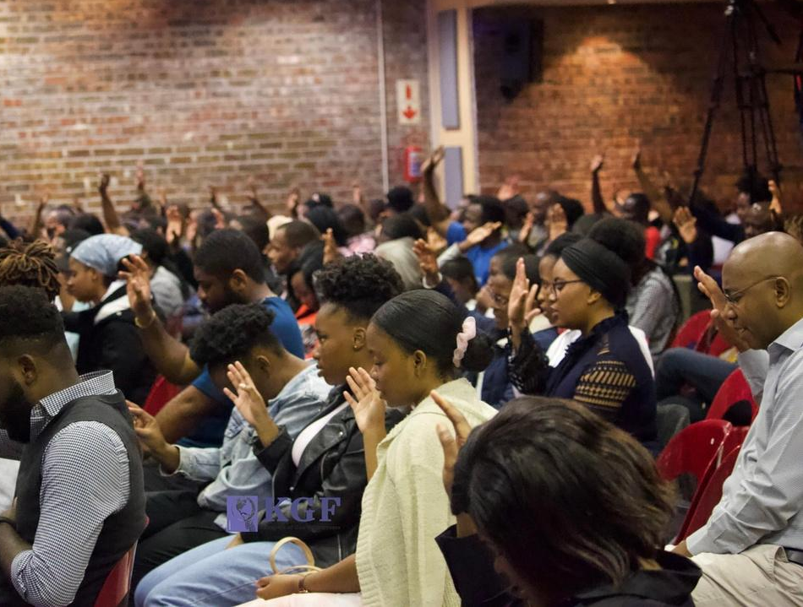
About Us
Who We Are
Keepers of God's Fortresses’ (KGF) was founded in April 2010 by Pastor Beatrice Katshunga in Cape Town, South Africa as a Christian faith-based organisation. KGF is a ministry focused and centered on prayer.
As a ministry, our aim is to provide a platform where prayer can become more central in the life of a believer.
Prayer & Intercession

Slide 5
Our Mission &Vision
Pray effectively
01
Equip intercessors worldwide to pray effectively
02
Young people
Young people to have a passion for prayer
Spiritual awareness
03
Raise awareness of the spiritual realities that govern our nations
Tangible results
04
Train men and women to engage in spiritual warfare that yields tangible results
05
Re-establish the kingdom
Re-establish the kingdom of God as the first and final authority in our world

Slide 6
Young Warriors
Children need to have an understanding of the importance of prayer and mature from being forced or obliged by a parent or guardians to pray.
Vision
Exist to groom children to learn how to stand in prayer. We train children ages 10 to 16 as we trust God to raise the intercessors of tomorrow.
Our Aim
When each child completes the course he/she must be able to stand and possibly lead others in prayer.

Slide 7
10-16 years
Young Warriors
Highlights
We had 19 children enrolled for the class of 2022
The children enjoyed the sessions we had and asked for more
The curriculum was completed
The children were involved during our prayer conference
Challenges
Some students could not fully participate because of transport challenges

Slide 8
16+ years
Warriors Intercessors
Highlights
Met at least once a month
The attendance ranged from 7-10 children
Challenges
Most of the teens attend other extra murals for school and youth meetings on alternate Saturdays.

Slide 9
Testimonials
Young Warriors impacted my prayer life, and I am grateful that these lessons are here to help us improve our prayer
Young Warriors has taught me that prayer is not about impressing my family or friends and helped me build a stronger connection with God.
Young Warriors has impacted my life by making me read the Bible more often and this made my prayer life better.
Medine Kanyinda
Davina Kalenga
Beni Kanyinda

Slide 10
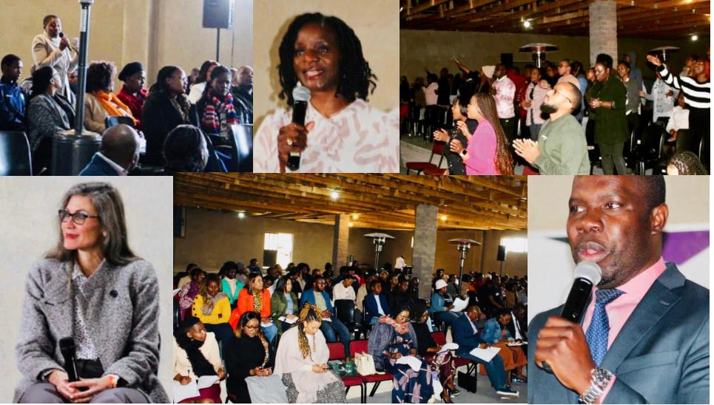
Prayer Workshop
2022
Hosted our annual Prayer Workshop for the first time in Johannesburg at Riverside Church led by Ps Khongelani & Asanda Chauke
Highlights
Year Overview

Slide 11
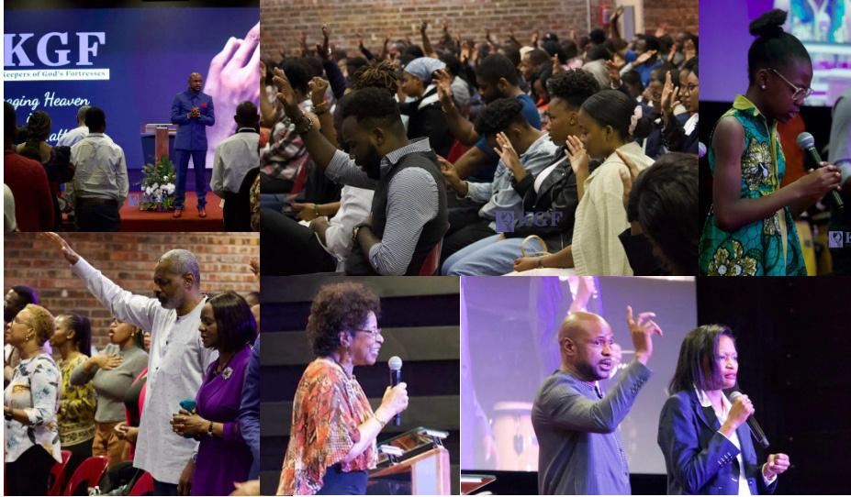
Annual Prayer Conference
2022
Hosted our 13th annual Prayer Conference themed ‘Conquering New Ground through Intercession’. Our guest speaker was Ps Bernard Fwamba from Ministère International de la Réconciliation Evangelique par le Christ
Highlights
Year Overview

Slide 12
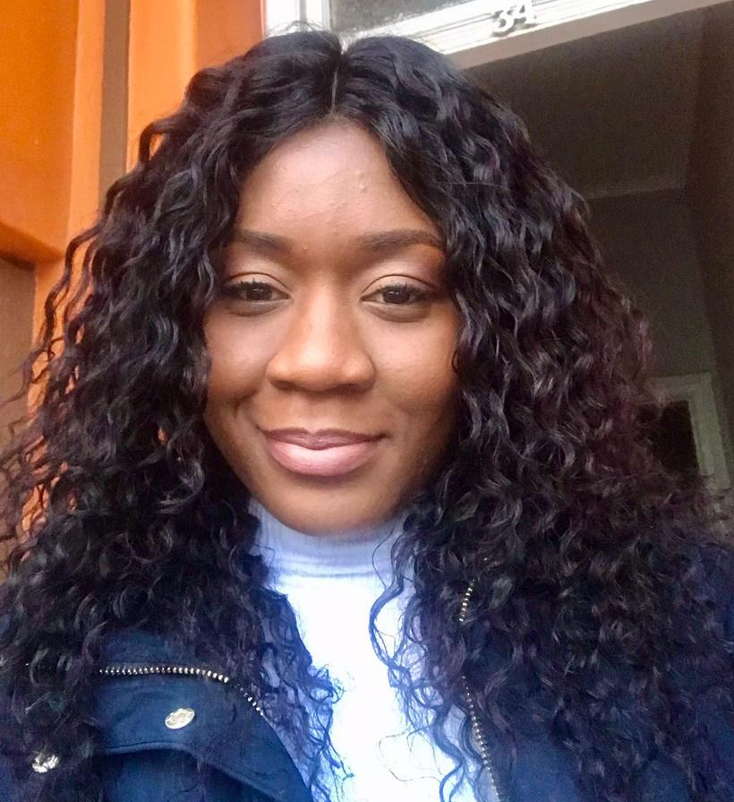
Intercession Team
KGF had 16 intercessors who were equipped on how to pray effectively and intercede for Churches, nations and families.
Testimonial
As a KGF intercessor, I have learned to pray with freedom and boldness. Ps Beatrice has taught us that when we come into God’s presence, we should express ourselves and pray freely and openly.
Morelle Ngandjou

Slide 13
Partnering With Us
We welcome donations and sponsorship at any point in time and have various ways through
which you can give to our organization.
For efficient planning, we encourage partnering with us through periodic donations, in intervals most suitable for you. Please visit our website www.keepers.org.za for more information.

Slide 14
Merchandise Products

Slide 15
Prayer Workshop
2023
Dates: 27-29 July 2023
Venue: Riverside Christian Church
Johannesburg, South Africa
Please email us for more details:(info@keepers.org.za)
Plans
As a ministry, we have continued to prioritize our efforts towards providing a platform where prayer can become more central in the life of a believer as we believe that prayer is the key area that can bring about restoration in families, churches and nations to God’s original intent and bringing about the will of God on earth as it is in heaven.

Slide 16
Get Connected With Us
Contact Information
Keepers of God's Fortresses
www.keepers.org.za
@kgf_2010
info@keepers.org.za
Keepers of God's Fortresses - KGF

Slide 17
THANK YOU

